Slide 1
Employee Attrition Prediction Model
Baldemar Aguirre Fraire

Slide 2
Exploratory Data Analysis
The “left” column is the outcome variable, 0 is for employees who stayed in the company and 1 for those who didn't.
satisfaction_level average_montly_hours Work_accident promotion_last_5years
left
0 0.666810 199.060203 0.175009 0.026251
1 0.440098 207.419210 0.047326 0.005321
The average satisfaction level of employees who stayed with the company is higher than that of the employees who left.
The average monthly work hours of employees who left the company is more than that of the employees who stayed.
The employees who had workplace accidents are less likely to leave than that of the employee who did not have workplace accidents.
The employees who were promoted in the last five years are less likely to leave than those who did not get a promotion in the last five years.

Slide 3
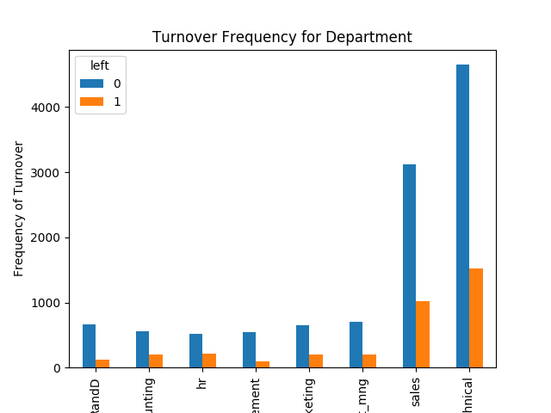
Data Visualization

Slide 4
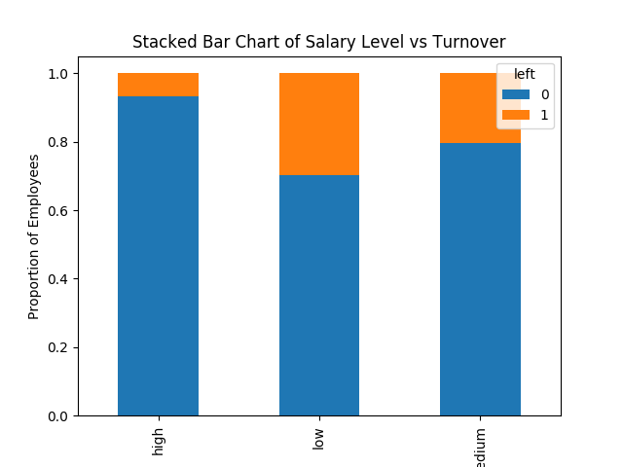
Bar chart for employee salary level and the frequency of turnover

Slide 5
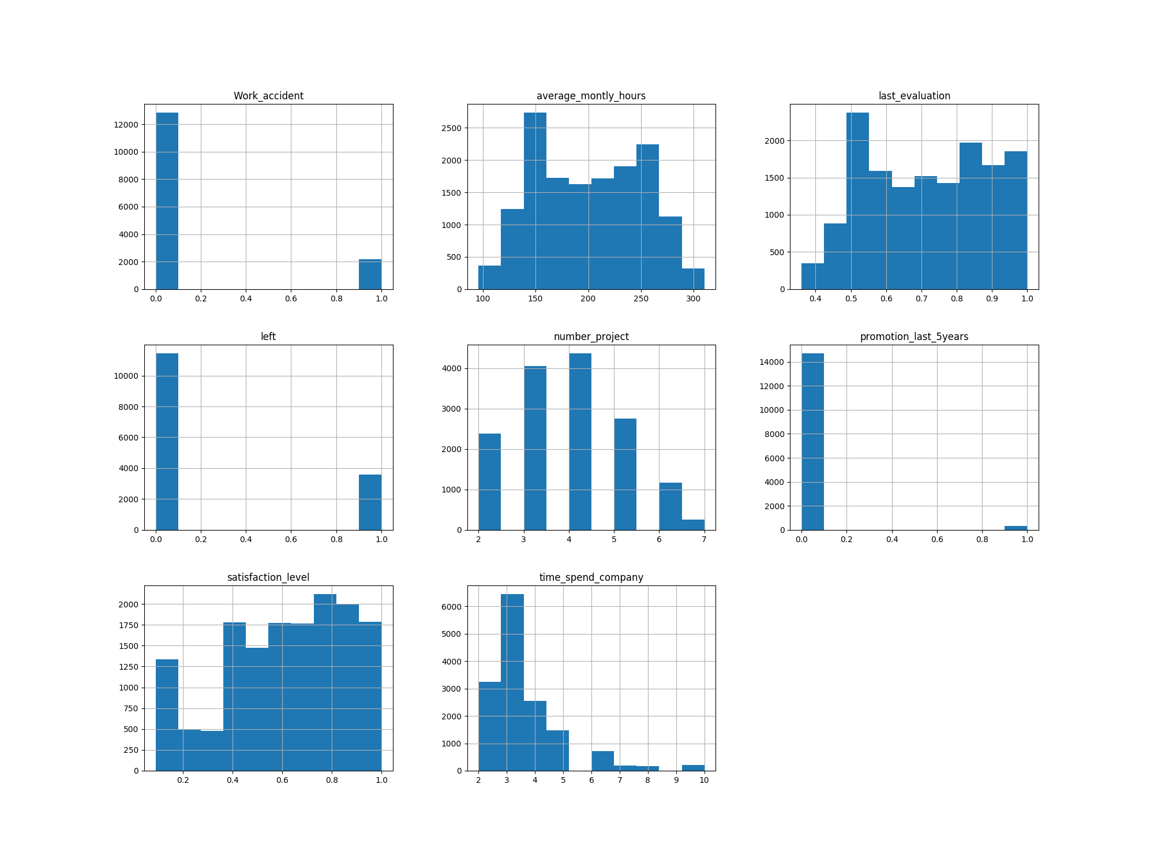

Slide 6
Feature Selection
Finding which variables are significant to predict employee attrition:
['satisfaction_level' 'last_evaluation' 'time_spend_company'
'Work_accident' 'promotion_last_5years' 'department_RandD'
'department_hr' 'department_management' 'salary_high' 'salary_low']

Slide 7
Machine learning models
Logistic Regression:
Logistic regression accuracy: 0.771
Random Forest:
Random Forest Accuracy: 0.978
Support Vector Machine:
Support vector machine accuracy: 0.907

Slide 8
Cross Validation
Cross validation attempts to avoid overfitting while still producing a prediction for each observation dataset.
10-fold cross validation average accuracy: 0.982
The average accuracy remains very close to the Random Forest model accuracy; hence, we can conclude that the model generalizes well.

Slide 9
Precission and recall
Random Forest:
precision recall f1-score support
0 0.99 0.98 0.99 3462
1 0.94 0.96 0.95 1038
accuracy 0.98 4500
macro avg 0.97 0.97 0.97 4500
weighted avg 0.98 0.98 0.98 4500

Slide 10
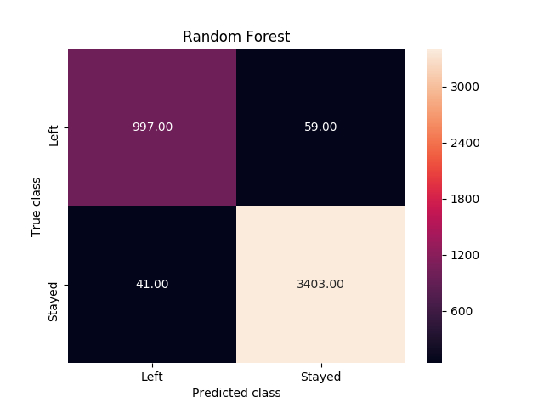

Slide 11
Precission and recall
Logistic Regression:
precision recall f1-score support
0 0.81 0.92 0.86 3462
1 0.51 0.26 0.35 1038
accuracy 0.77 4500
macro avg 0.66 0.59 0.60 4500
weighted avg 0.74 0.77 0.74 4500

Slide 12
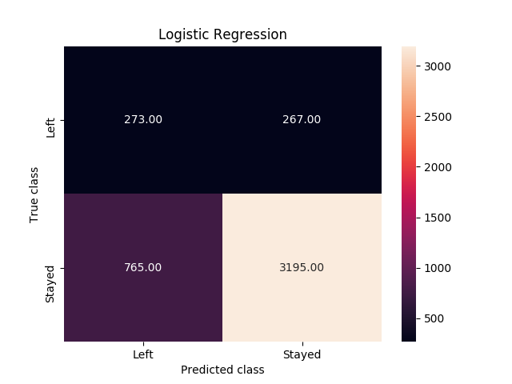

Slide 13
Precission and recall
Support Vector Machine:
precision recall f1-score support
0 0.95 0.92 0.94 3462
1 0.77 0.85 0.81 1038
accuracy 0.91 4500
macro avg 0.86 0.89 0.87 4500
weighted avg 0.91 0.91 0.91 4500

Slide 14
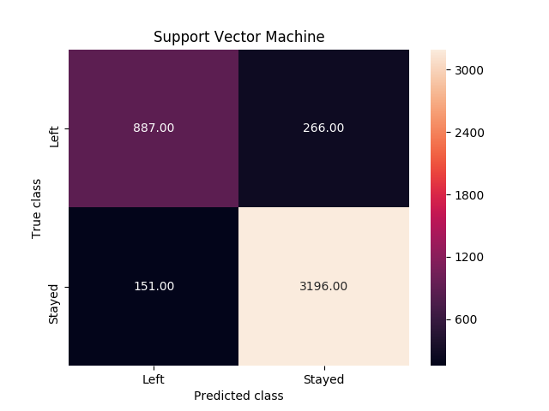

Slide 15
Precission and recall
When an employee left, how often does the classifier predict that correctly? This measurement is called “recall”; out of all the turnover cases, random forest correctly retrieved 997 out of 1038. This translates to a turnover “recall” of about 96% (997/1038), far better than logistic regression (26%) or support vector machines (85%).
When a classifier predicts an employee will leave, how often does that employee actually leave? This measurement is called “precision”. Random forest again outperforms the other two at about 94% precision (997 out of 1056) with logistic regression at about 51% (273 out of 540), and support vector machine at about 77% (887 out of 1153).

Slide 16
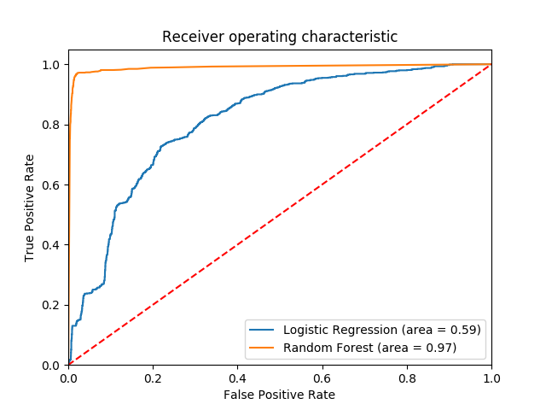
The ROC Curve

Slide 17
The ROC Curve
The receiver operating characteristic (ROC) curve is another common tool used with binary classifiers. The dotted line represents the ROC curve of a purely random classifier; a good classifier stays as far away from that line as possible (toward the top-left corner).

Slide 18
Feature Importance for Random Forest Model
department_management-0.25%
promotion_last_5years-0.25%
department_hr-0.31%
department_RandD-0.33%
salary_high-0.74%
salary_low-1.11%
Work_accident-1.51%
last_evaluation-18.57%
time_spend_company-26.41%
satisfaction_level-50.52%
According to our Random Forest model, the above shows the most important features which influence whether an employee will leave the company, in ascending order.

Slide 19
Reference
https://towardsdatascience.com/predict-employee-turnover-with-python-da4975588aa3

